Slide 1
NPTEL MOOCs course on
Phonetics and Phonology:
A Broad overview
Shakuntala Mahanta
Department of Humanities and Social Sciences
Indian Institute of Technology Guwahati

Slide 2
Unit 2 Acoustic phonetics
Shakuntala Mahanta

Slide 3
Introduction
Sound is variation in air pressure detectable by the human ear.
It is a wave characterized by the transmission of energy in the form of compression (increased pressure), and rarefaction (decreased pressure) through the medium, a travelling pressure fluctuation.

Slide 4
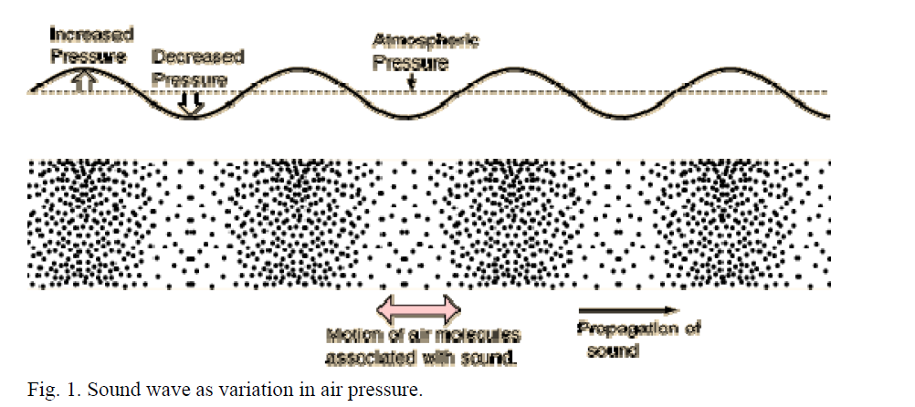

Slide 5
Acoustic phonetics: Sound waves
What type of a wave is a sound wave?
Mechanical waves vs. electromagnetic waves
Sound waves are mechanical waves, i.e. they rely on the movement of particles that make up the medium (air, water, etc) for their propagation.
Unlike electromagnetic waves that constitute their own medium (e.g., photons in the case of light), sound waves depend on external physical media.
If there is no medium of transmission, there will be no sound.

Slide 6
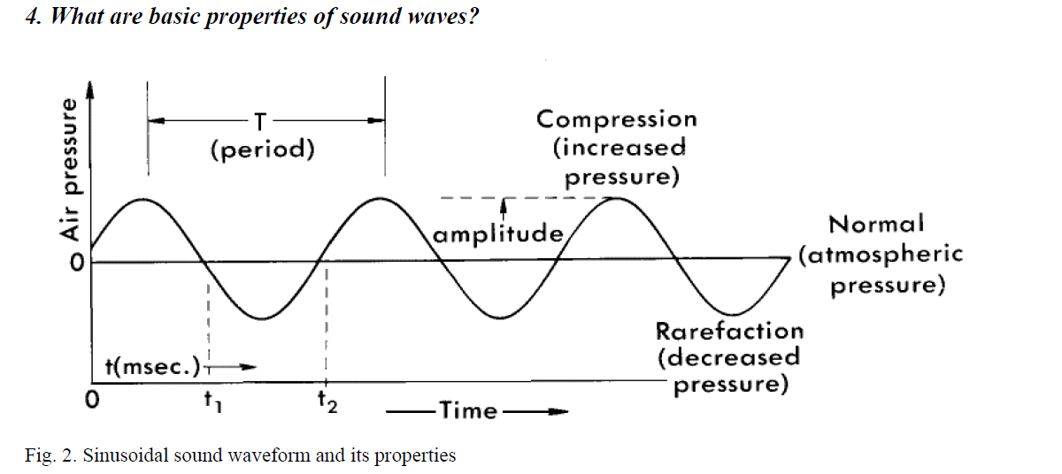
Acoustic phonetics: Sound waves

Slide 7
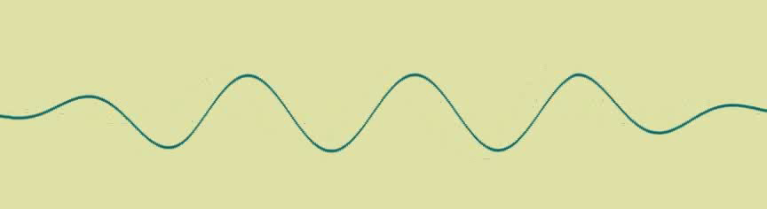
Acoustic phonetics: Sound waves
Transverse waves vs. longitudinal waves
Transverse waves are waves in which the direction of particle movement is at the right angle to the direction of the wave propagation (e.g. waves on the surface of water).
Fig. 3. Transverse wave

Slide 8
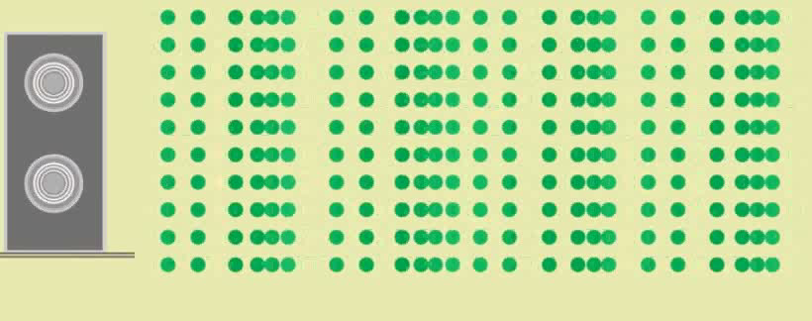
Acoustic phonetics: Sound waves
Longitudinal waves are waves in which particles moves back and forth along the line of the travelling wave.
All sound waves are longitudinal waves.
Fig. 4. Longitudinal wave travelling in the form of compressions and rarefactions

Slide 9

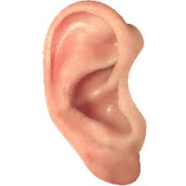

Acoustic phonetics: Sound waves
Layers of air (tiny air particles)
Layers of air (tiny air particles)
No vibration stationary
vibration
compressions
rarefactions
1 wave = 1 compression + 1 rarefaction
Fig. 5. Propagation of sound

Slide 10
Acoustic phonetics: Sound waves
Period (T) is the amount of time needed to complete one cycle of movement.
It is measured in second(s) and its fractions (millisecond, nanosecond, etc.).
Frequency (f) is the number of cycles completed in one second.
It is measured in cycles per second, a unit of measurement known as Hertz (Hz).
Human ear can pick up frequencies in the range between 20 and 20,000 Hz.
The perceptual correlate of frequency is pitch.
Relation between frequency and period is f = 1/T e.g. a wave with a period of 1/100th of a second has a frequency of 1/0.01=100Hz

Slide 11
Acoustic phonetics: Sound waves
Amplitude (A) is the maximum displacement from the equilibrium position.
In the case of sound waves, it is the extent of the maximum variation in air pressure from normal atmospheric pressure.
Amplitude is related to loudness, when amplitude decreases the sound becomes less loud.
Two waves can have the same frequency but different amplitude and vice versa

Slide 12
Acoustic phonetics: Sound waves
Standard speed of sound is ≈330 m/s, it is the velocity of the sound in the air (anything moving above this velocity is supersonic.).
If the sound is transmitted through solids, liquids or gases other than air the speed of sound will vary depending on that medium.

Slide 13
Acoustic phonetics: Sound waves
What types of waveforms can we encounter?
Sinusoidal
Simple waves are also called sinusoidal/sine waves; they result from simple harmonic motion and are made up of a single frequency component.
Each cycle of the movement takes exactly the same time represented as a uniform circular motion on a plane (hence the terms cycle, sine wave).

Slide 14

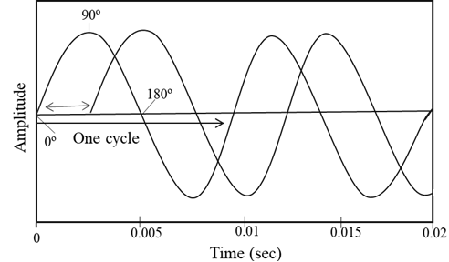
Acoustic phonetics: Sound waves
Fig. 6. A simple 100 Hz sine wave
Fig. 7. Tow sine waves with identical frequency and amplitude, but 90º out of phase.

Slide 15
Acoustic phonetics: Sound waves
Addition of sine waves of the same frequency produces another sine wave of greater amplitude
Addition of sine waves of different frequencies results in a complex wave, therefore any complex wave always have more than one frequency component.
It is possible to construct an infinite variety of complex waves by combining sine waves of difference amplitudes and frequencies
All complex waves can be regarded as a sum of a (possibly infinite) number of sine waves (Fourier’s theorem).
Fourier analysis is a mathematical technique for decomposing a complex wave into its component sine waves. Result is the spectrum of sound.

Slide 16
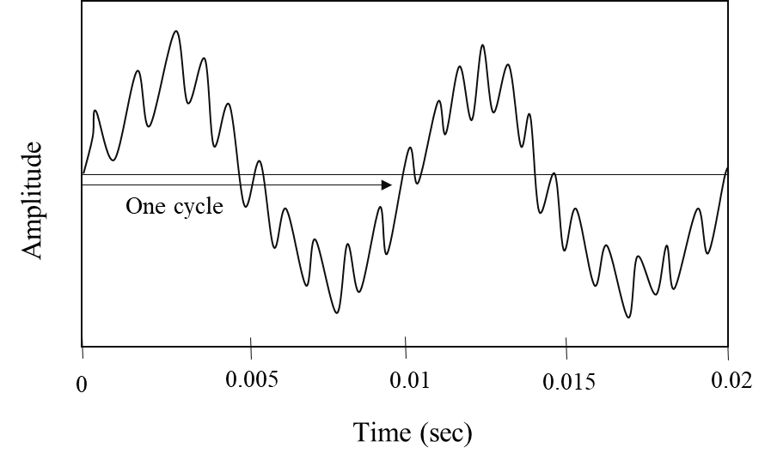
Acoustics: Sound waves
Fig. 8. A complex periodic wave composed of 100 Hz sine wave and a 1,000 Hz sine wave. One cycle of the fundamental frequency (F0) is labeled.

Slide 17
Acoustic phonetics: Sound waves
The horizontal axis of a spectrum corresponds to frequency and the vertical axis corresponds to amplitude of the individual components in the complex wave.
Fig. 9 show spectra of a sine wave and a complex wave respectively. Fourier's technique is very powerful.
Sine waves are easy to deal with mathematically and the representation of complex functions as sine waves often makes analysis much less difficult.

Slide 18
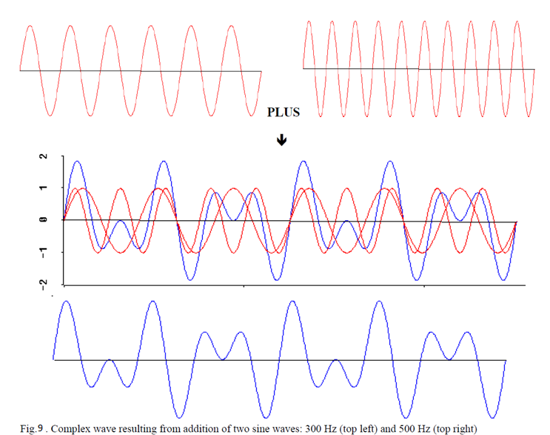
Acoustic phonetics: Sound waves

Slide 19
Acoustic phonetics: Sound waves
Periodic waves have a pattern that repeats itself at regular intervals.
Additionally, there are quasiperiodic waves that may be not quite regular or not wholly repeating.
Vowel sounds are examples of quasi-periodic sound waves.
The frequency components of sine waves that make up a complex periodic wave are called harmonics.
The lowest harmonic is fundamental frequency (f0).
All higher harmonics – also called overtones or partials – are integer multiples of the fundamental frequency.

Slide 20


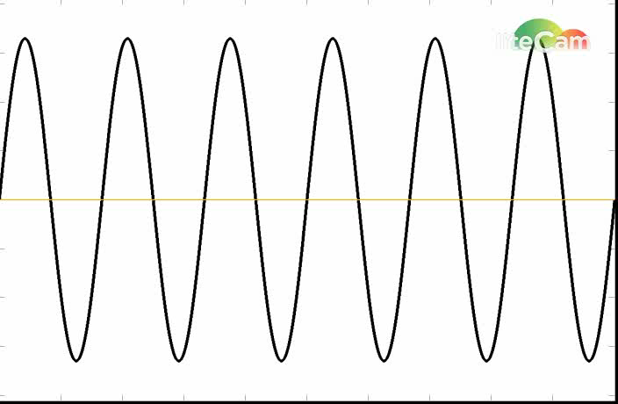
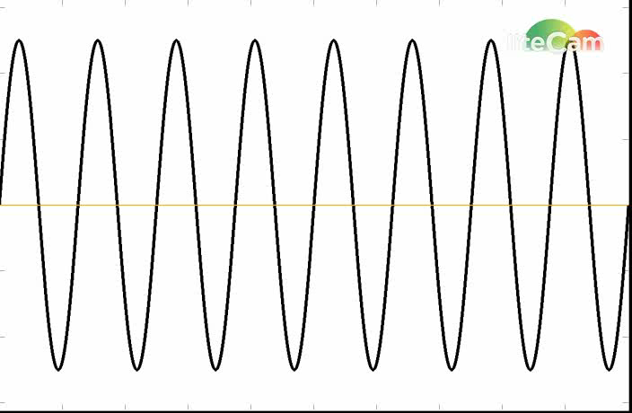
Acoustic phonetics: Sound waves
100 Hz, amp 1
200 Hz, amp 0.5
300 Hz, amp 0.33
400 Hz, amp 0.25

Slide 21
Acoustic phonetics: Sound waves
Aperiodic waves do not have a regular repeating pattern and are perceived as noises.
They do not have a harmonic basis, i.e. the component frequencies, of which they are made up, are not related to each other
Their component frequencies are not integer multiples of fundamental frequency).

Slide 22
Acoustic phonetics: Sound waves
Continuous vs. transient waves
Aperiodic waves are further divided into two groups. The first compromises continuous waveforms that have random patterns.
White noise is an ideal example of aperiodic noise characterized by absolutely random pressure fluctuations, other examples – hissing, flow of water, whisper.
Although continuous aperiodic waves do not have harmonic structure it is still possible to perform Fourier analysis on them. Aperiodic sounds are better represented by continuous rather than line spectra

Slide 23
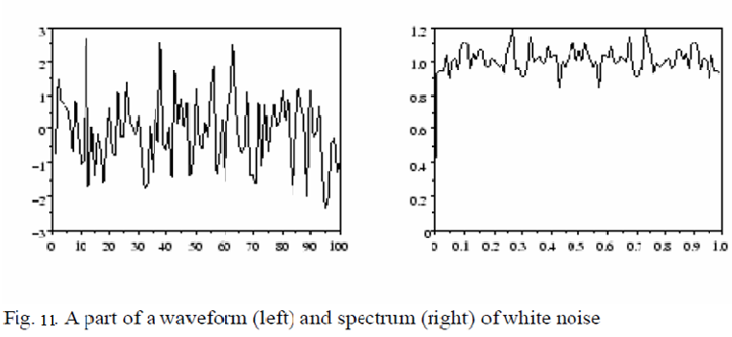
Acoustic phonetics: Sound waves

Slide 24
Acoustic phonetics: Sound waves
Transient sounds are characterized by a sudden pressure fluctuation that is not sustained or repeated over time.
Examples of transient noises include hammer hitting the table, the slamming of a door, the popping of a balloon.
Transient sounds can also be analysed into the spectral components using Fourier analysis.
In ideal (theoretical) case the spectrum of a transient sound contains an infinite range of frequencies at approximately equal amplitude for an infinitely brief period of time.

Slide 25

Acoustic phonetics: Sound waves
Fig. 12. A 20 ms section of an acoustic waveform of white noise. The amplitude of any given point in time is random.

Slide 26
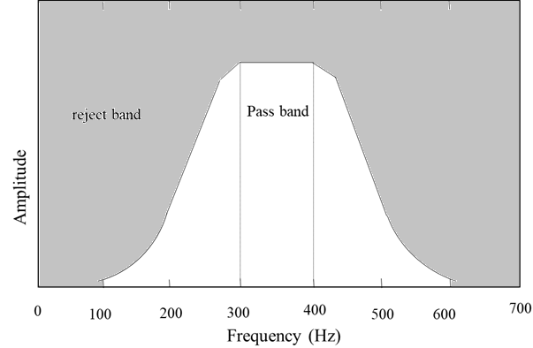
Acoustic phonetics: Sound waves
Fig. 13. Illustration of a band-pass filter. The filter has skirts on either side of the pass band.

Slide 27
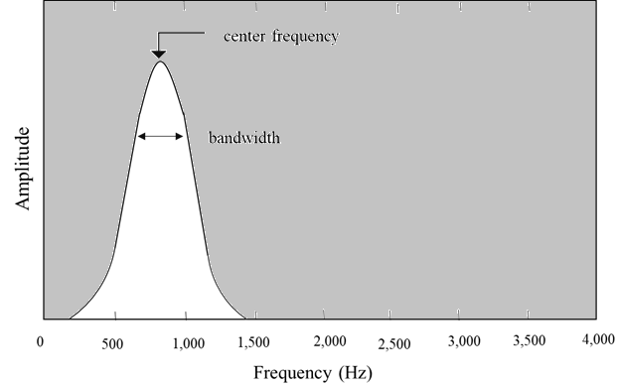
Acoustic phonetics: Sound waves
Fig. 14. A band-pass filter described by the center frequency and bandwidth of the filter.

